Slide 1
Computer Science and Engineering with Data Science(CSD)
Major Project Stage 2 (2024-2025)
IV B.Tech I Semester
G.A.R.V.I.S
(GPT-Assisted Robotic Voice Interactive System)
Project Team :
Bandra Anusha (21E51A6704)
Adithya chilupuri (21E51A6707)
Thakur Aryan Singh (21E51A6760)
V.Ramesh (21E51A6762)
Project Guide:
Mr.Nava Kishore

Slide 2

Abstract
This project presents GARVIS, an intelligent virtual assistant designed to enhance everyday life through seamless interaction and personalized support. Inspired by existing assistants like Cortana and Siri, Garvis mploys voice and keyboard input to facilitate natural communication. Leveraging machine learning, it learns from user interactions to tailor responses and optimize task management. Garvis excels at organizing schedules, setting reminders, conducting web searches, and providing personalized recommendations across various domains, including health and lifestyle. As a general-purpose desktop application, Garvis significantly boosts productivity by efficiently handling routine tasks and delivering timely information.

Slide 3
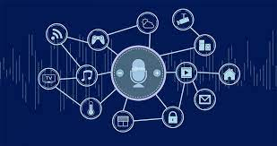
Significance and Relevance
The evolution of artificial intelligence has paved the way for innovative tools that enhance daily productivity and simplify complex tasks. Our project, G.A.R.V.I.S. (GPT-Assisted Robotic Voice Interactive System), represents a cutting-edge virtual assistant designed to revolutionize the way users interact with their desktop environments. Building on the foundational concepts of natural language processing (NLP), speech recognition, and machine learning, G.A.R.V.I.S. aims to provide a highly intelligent and user-friendly interface capable of managing diverse tasks effectively

Slide 4
Objectives of project
The objectives of the G.A.R.V.I.S. project are as follows:
Enhanced Productivity: Provide users with a versatile virtual assistant capable of automating routine tasks and streamlining workflows to save time and effort.
Personalized User Experience: Leverage machine learning and GPT algorithms to adapt to individual user preferences and needs, ensuring a tailored interaction experience.
Comprehensive Functionality: Integrate features such as schedule organization, web searches, multimedia retrieval, and health recommendations to cater to diverse user requirements.
Seamless Interaction: Utilize NLP and advanced speech recognition to enable natural and intuitive communication through voice and keyboard inputs.
Real-Time Optimization: Deliver accurate and timely responses by analyzing user inputs and utilizing cutting-edge AI algorithms for efficient task execution.

Slide 5
Literature Survey
DESKTOP AI ASSISTANT: J.A.R.V.I.S JUST A RATHER VERY INTELLIGENT SYSTEM
The J.A.R.V.I.S. project is designed to handle various tasks via voice commands, like setting reminders, conducting web searches, sending emails, and recognizing faces. Its foundation is NLP and speech recognition, using Python libraries like speech_recognition and APIs like Google's Speech Recognition. This enables it to process voice commands conversationally.
https://www.jetir.org/papers/JETIR2403582.pdf
JOURNAL: JETIR (Journal of Emerging Technologies and Innovative Research) 2024

Slide 6
Literature Survey
JARVIS – THE VIRTUAL ASSISTANT
JARVIS is a desktop application that utilizes voice commands to assist users in performing tasks and responding to queries. The assistant offers functionalities like retrieving weather updates, fetching news, browsing the internet, and performing system operations, thus enhancing productivity by simplifying routine tasks.
https://www.irjmets.com/uploadedfiles/paper/issue_5_may_2022/22850/final/fin_irjmets1652381029.pdf
JOURNAL: IRJMETS (International Research Journal of Modernization in Engineering Technology and Science) 2022

Slide 7
Literature Survey
AI-Based Virtual Assistant Using Python: A Systematic Review
A software agent that will carry out tasks or provide services in response to a user\'s privately supported instructions or inquiries is known as an intelligent virtual assistant (IVA) or intelligent personal assistant (IPA). A virtual assistant capable of being accessed via web chat is sometimes called a \"chatbot.\" Online chat systems can occasionally only be used for amusement.
https://www.ijraset.com/research-paper/ai-based-virtual-assistant-using-python-a-systematic-review
JOURNAL: IJRASET (International Journal for Research in Applied Science and Engineering Technology) 2023

Slide 8
Literature Survey
VOICE ASSISTANT - A REVIEW
This study focuses on developing a Python-based intelligent software assistant to help the blind and visually impaired access Android devices and library resources.The app combines voice-to-text and text-to-speech to enhance usability, with positive feedback from visually impaired users. Although limited by reliance on Google libraries, it aims to foster productivity and independence, reducing social pressure and expanding access to resources.
https://www.ijeast.com/papers/157-158,Tesma511,IJEAST.pdf
JOURNAL: (International Journal of Engineering Applied Sciences and Technology) 2021

Slide 9
Literature Survey
Automating Desktop Tasks with a Voice-Controlled AI Assistant using Python
Virtual AI assistants are intelligent programs that use natural language processing to interpret and respond to human requests. They excel in speech recognition, response accuracy, and handling language challenges. Key features include Google search, Gmail integration, real-time news and weather updates, and support for popular platforms like WhatsApp and YouTube, enhancing their overall utility.
https://ijrpr.com/uploads/V5ISSUE5/IJRPR28935.pdf
JOURNAL: IJRPC (International Journal of Research Publication and Reviews) 2024

Slide 10
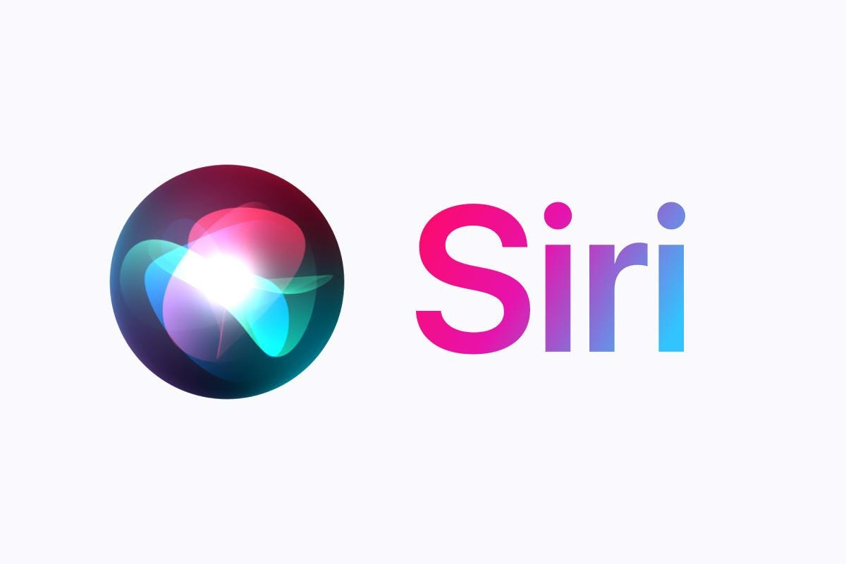
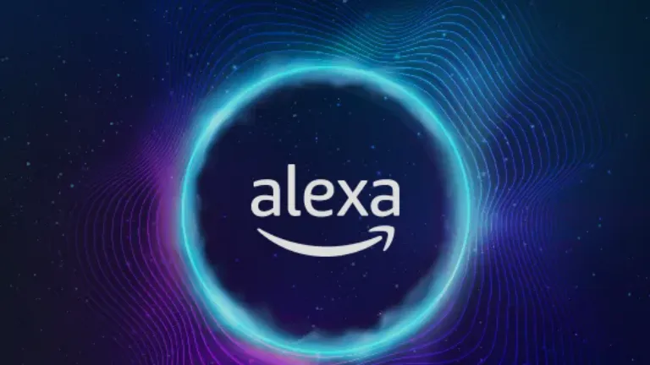
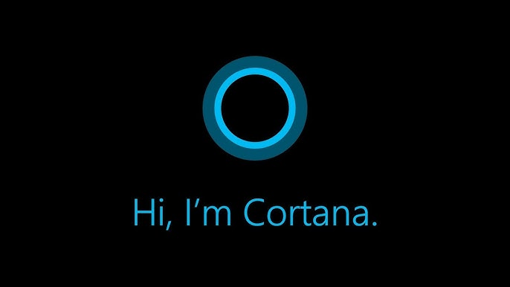
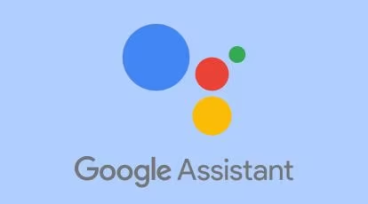
Existing System
SIRI from Apple
Alexa
Google Assistant
Cortana
DRAWBACKS
For using these assistants one should have an account (like Google account for Google
assistant, Microsoft account for Cortana) and can use it with internet connection only because these assistants are going to work with internet connectivity.They are integrated with many devices like,phones,laptops,and speakers etc.

Slide 11
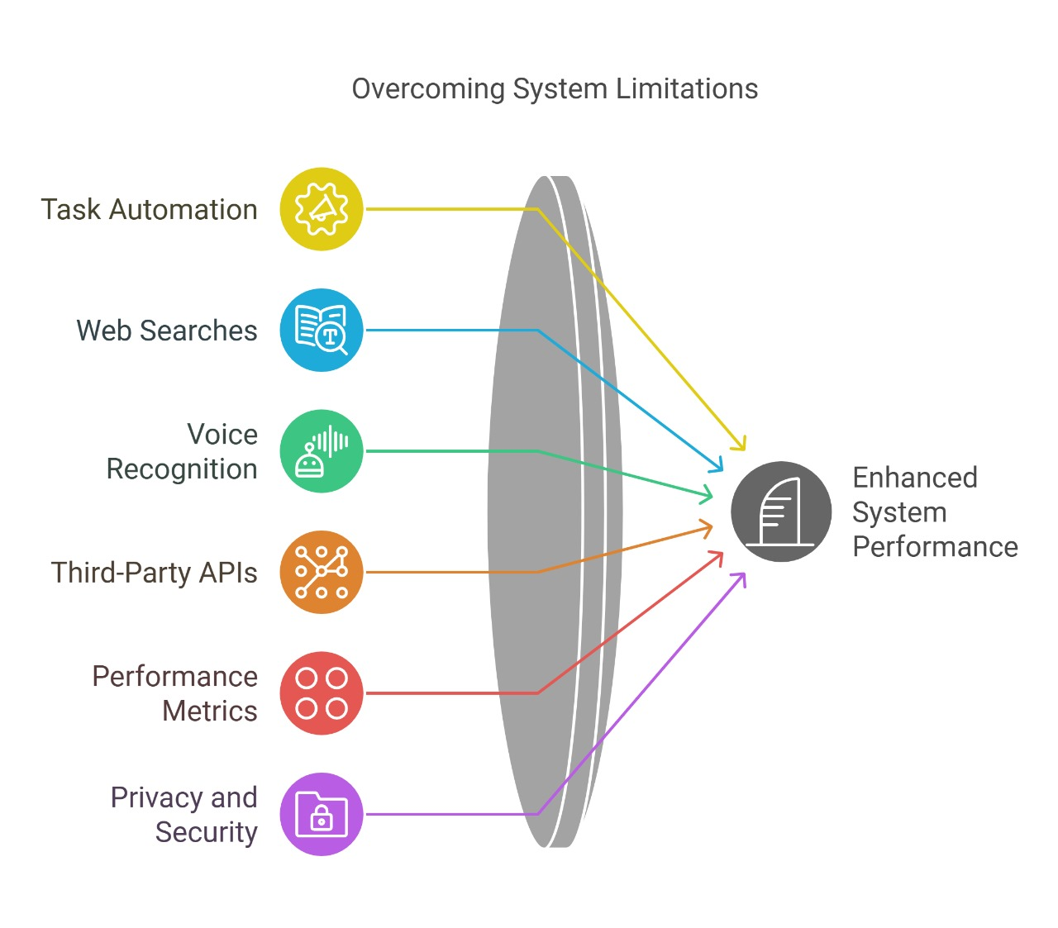

Slide 12
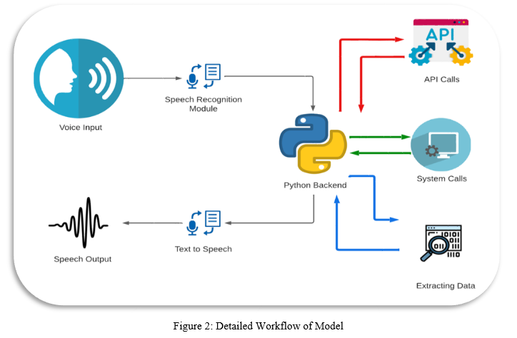
SYSTEM ARCHITECTURE

Slide 13
Technology Used in Personal Desktop Voice Assistant
Python – Core programming language with libraries for AI, NLP, and automation.
Speech Recognition APIs – Converts speech to text.
Natural Language Processing (NLP) Libraries – Understands and processes human language.
Text-to-Speech (TTS) Engines – Converts text to natural-sounding speech.
Machine Learning Frameworks – Enhances speech recognition & NLP.
GUI Libraries – Creates a user-friendly interface.
Web APIs – Integrates external services.

Slide 14
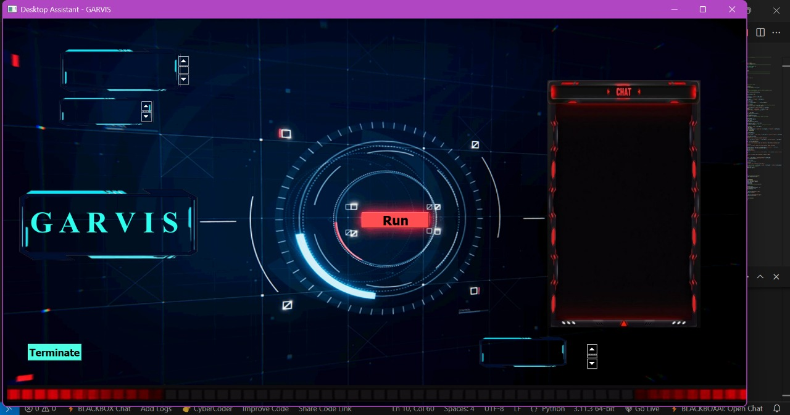
GUI DESIGN

Slide 15
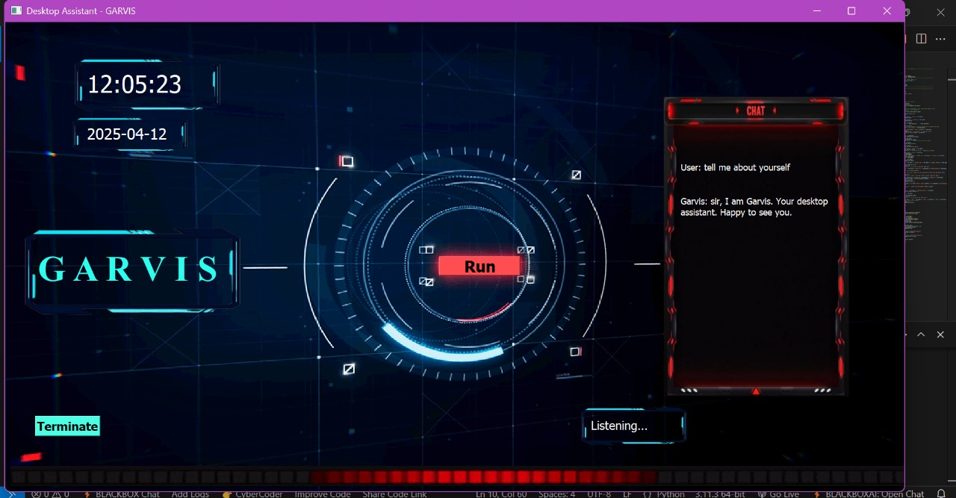
GUI DESIGN

Slide 16
CONCLUSION
Personal desktop voice assistants are becoming increasingly popular as users seek greater convenience, efficiency, and hands-free control in their daily tasks. With the advancement of natural language processing and machine learning, these assistants can now understand and respond to human queries in a more intuitive and conversational manner. They enhance productivity, improve accessibility, and offer entertainment options such as playing music or reading news. However, the growing use of such systems also raises important concerns around privacy and data security. It is essential for users to remain informed about how their data is collected and used. Overall, voice assistants like G.A.R.V.I.S have the potential to transform the way we interact with computers, making technology more personal, accessible, and intelligent. As innovation continues, these systems will only become smarter, more secure, and increasingly integrated into our daily digital lives.

Slide 17
FUTURE SCOPE
1. Multilingual Support
Enable G.A.R.V.I.S to understand and respond in multiple languages. Improve accessibility for non-English speakers.
2. Home Automation Integration
Connect with IoT devices (lights, thermostat, security). Control smart home appliances via voice commands.
3. Emotion Detection
Incorporate sentiment analysis to detect user mood or tone. Adapt responses based on emotional context for a more human-like experience.
4. AI-driven Scheduling
Integrate calendar/task management features. Smart reminders, meeting setup, and to-do tracking with proactive suggestions.

Slide 18
THANK YOU

